Slide 1

Remaining shell commands.
Sijumary Johnson

Slide 2
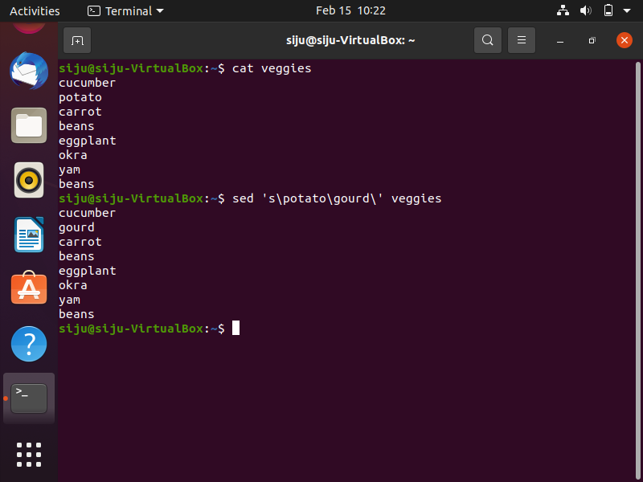
Regular expressions
It is a pattern used to match a particular pattern.
It can be used in a variety of programs like :- ed, sed, awk, grep, etc.

Slide 3
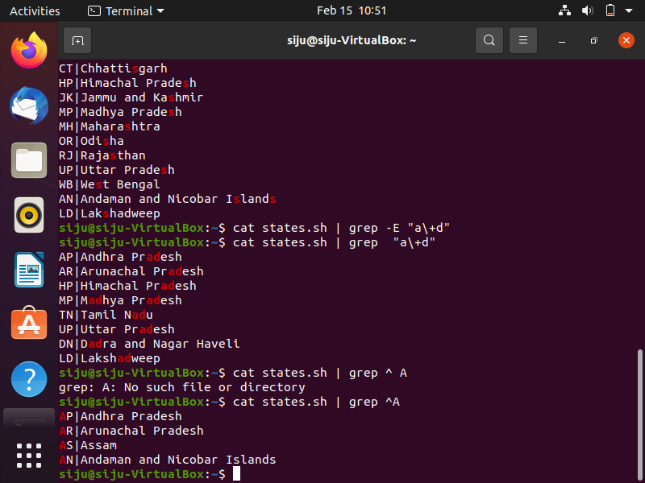
CONTD

Slide 4
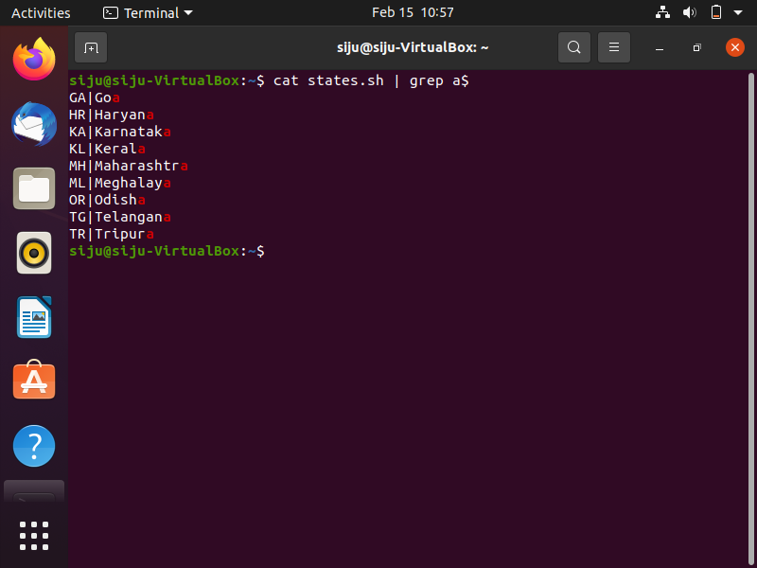
CONTD

Slide 5
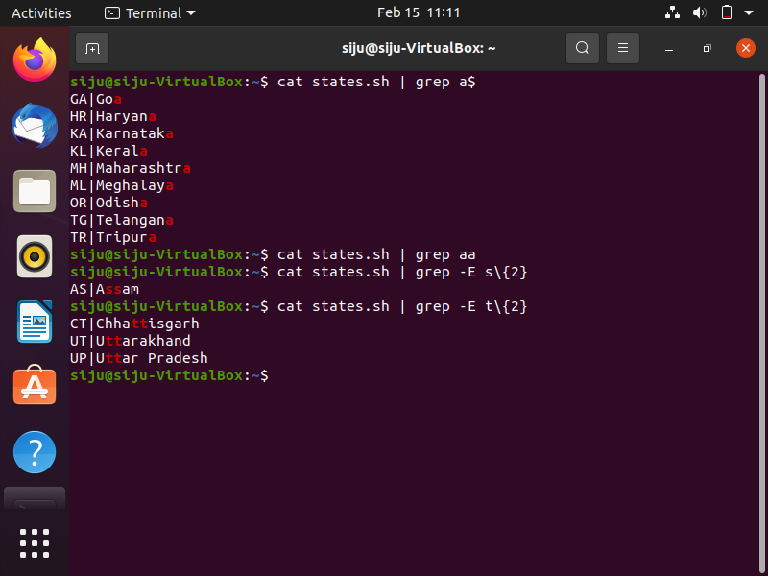
CONTD

Slide 6
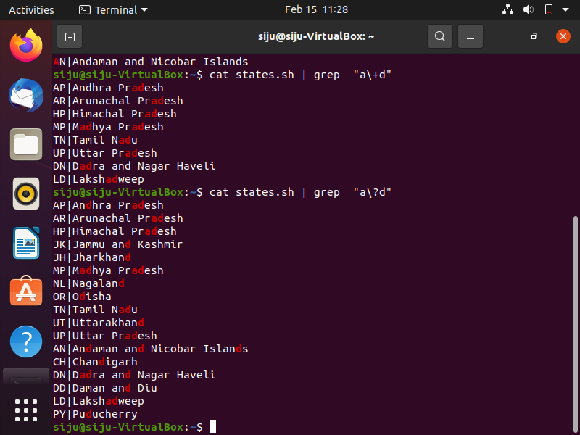
CONTD

Slide 7
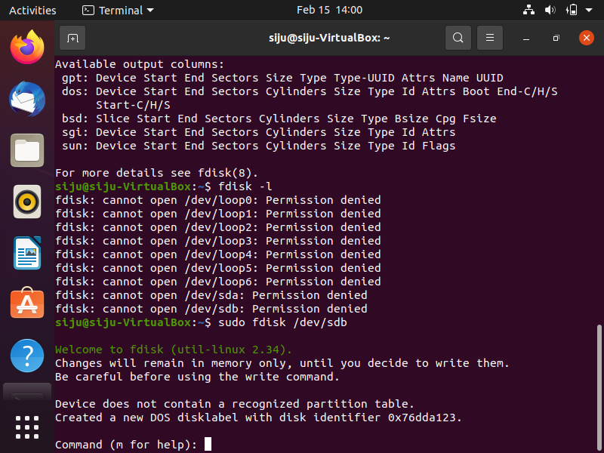
CREATING PARTITIONS

Slide 8
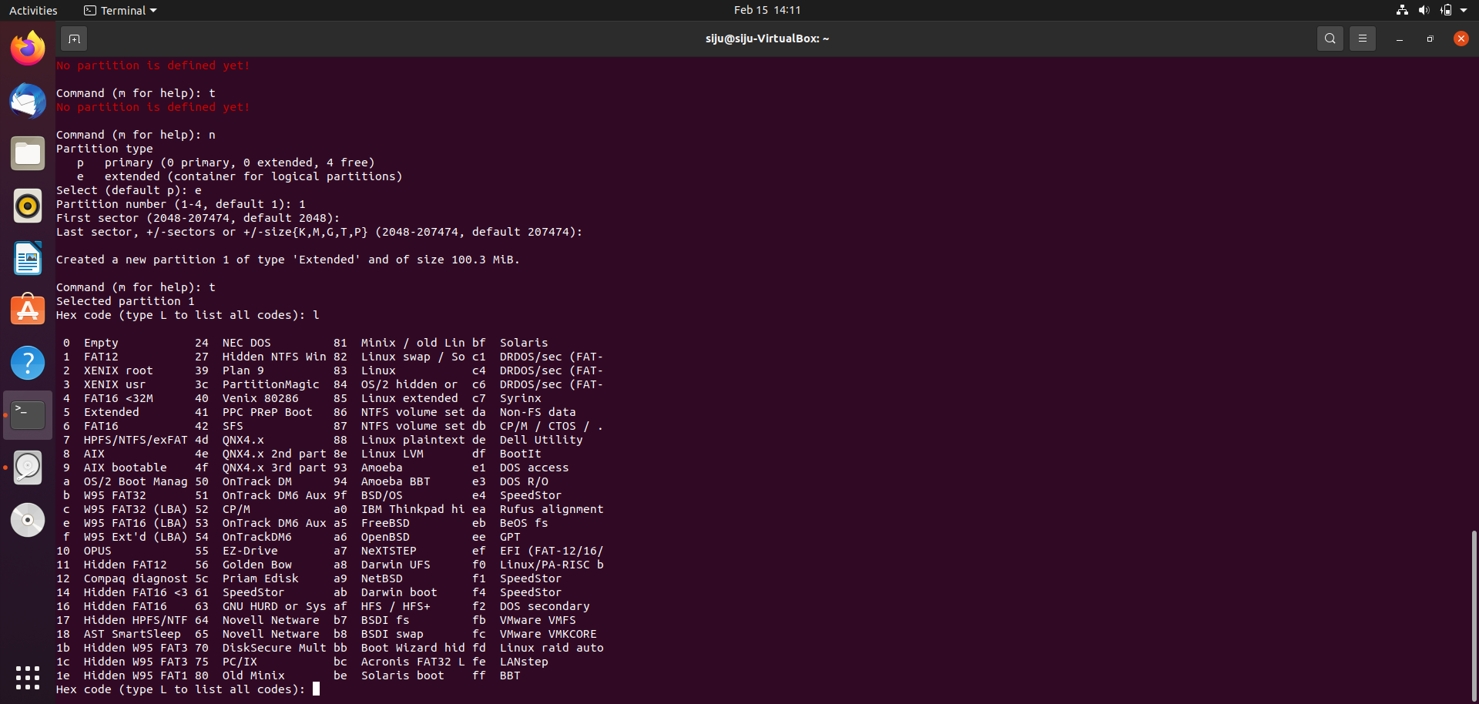
CONTD

Slide 9
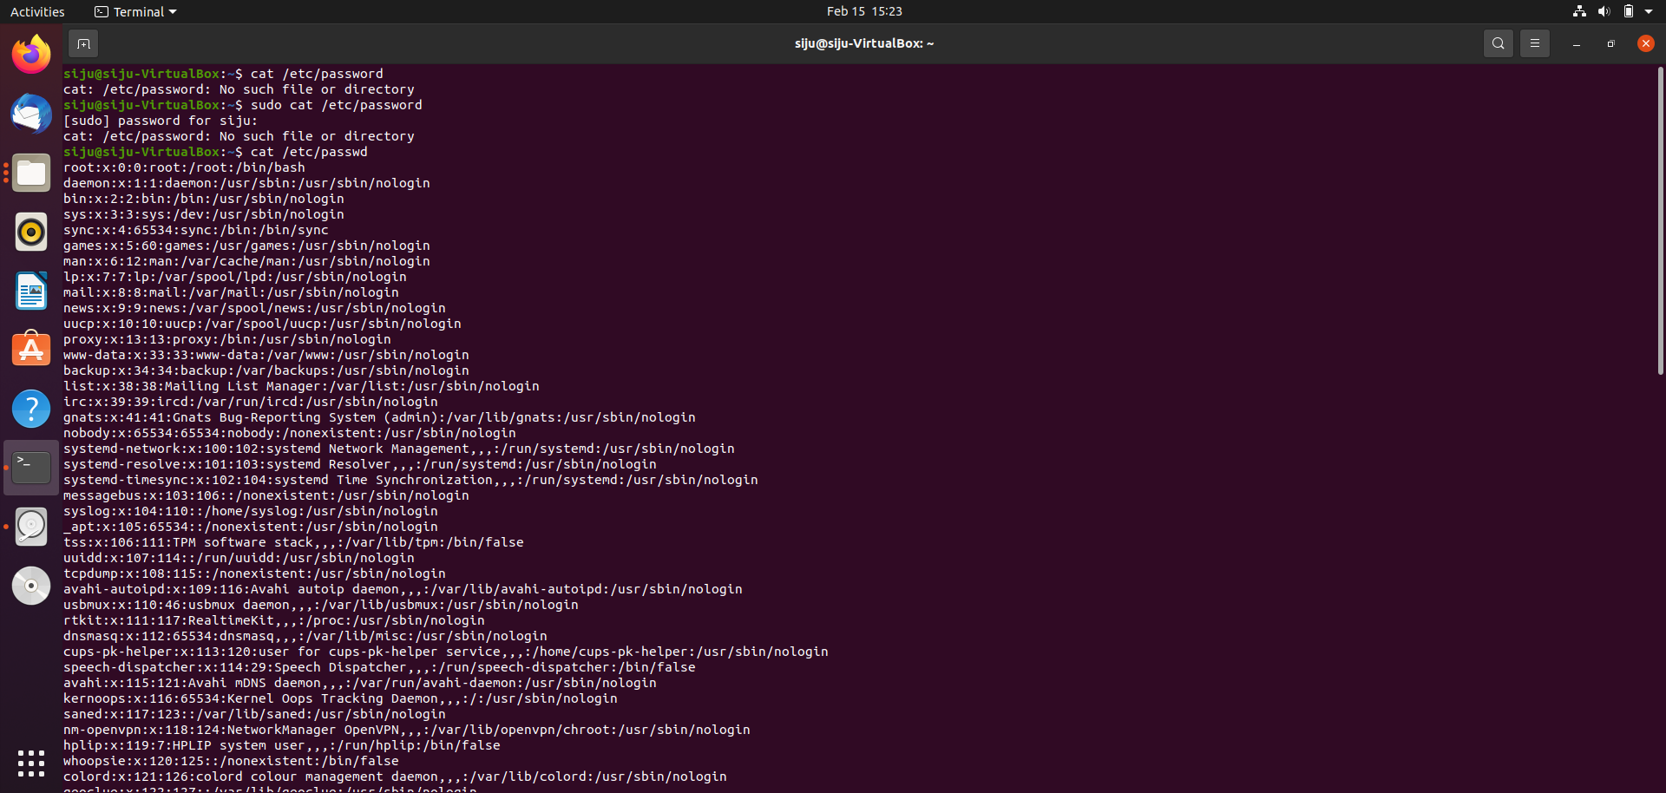
GETTING PASSWORD

Slide 10
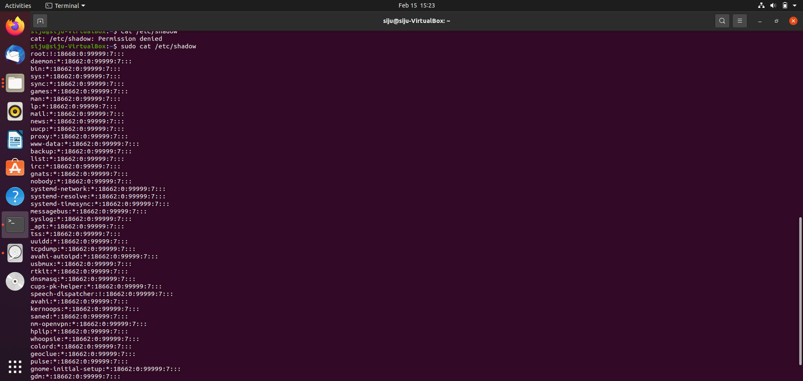
ENCRYPTED PASSWORD

Slide 11
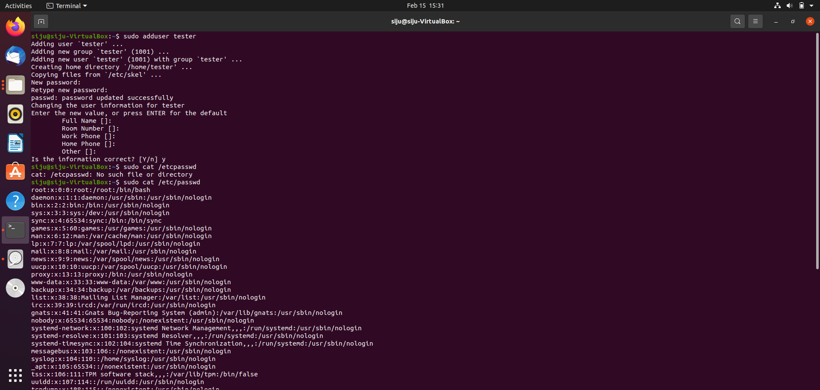
ADDING NEW USER

Slide 12
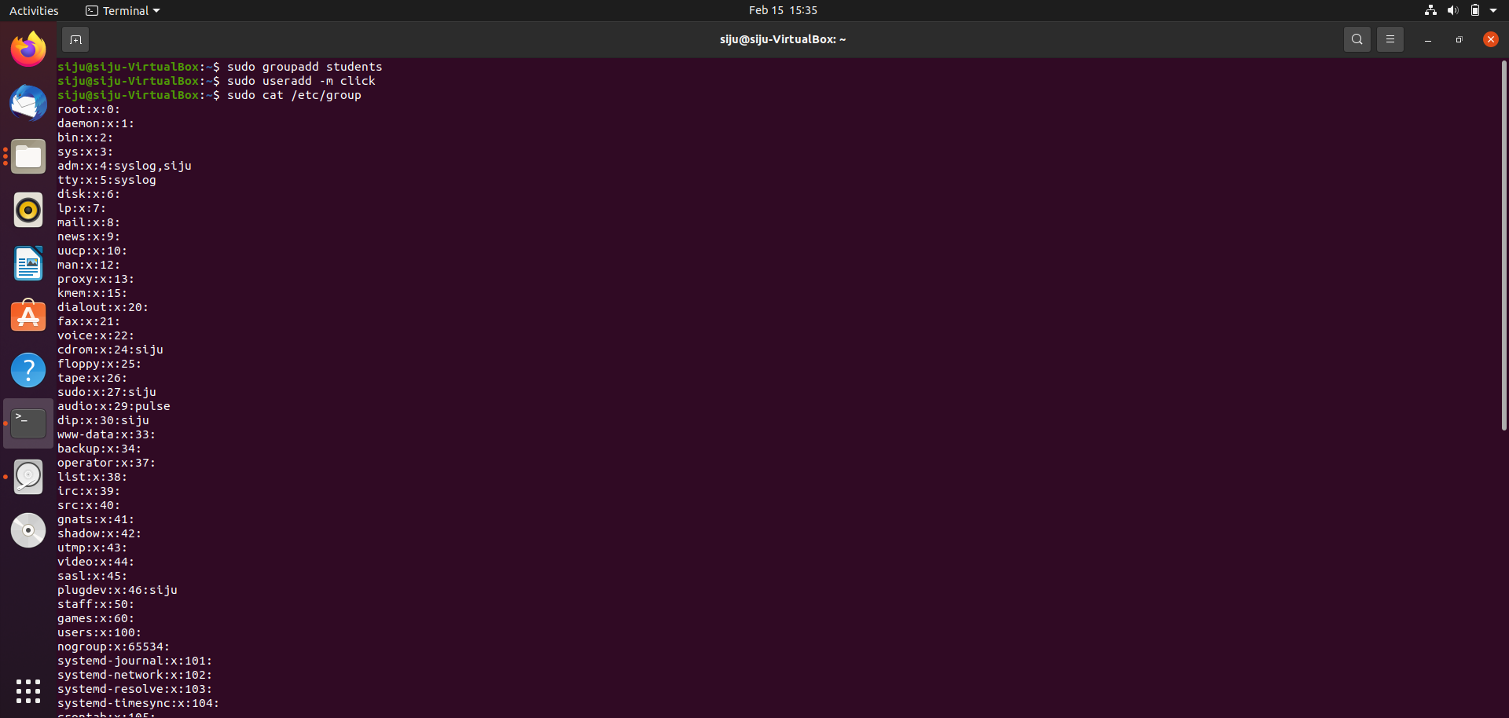
ADDING NEW GROUP

Slide 13
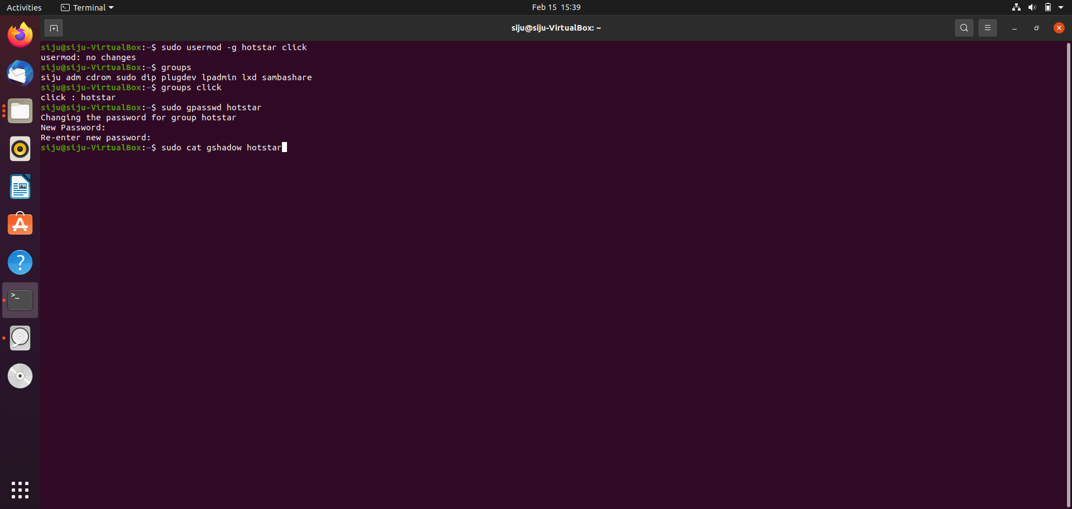
MODIFYING GROUP AND ITS PASSWORD

